Slide 1


Leveraging Youth Entrepreneurship for Sustainable Growth, 2025 National Progress Report and Strategic Outlook
NATIONAL INSTITUTE FOR POLICY AND STRATEGIC STUDIES (NIPSS) March, 2026
ECONOMIC DIVERSIFICATION AND NATIONAL DEVELOPMENT

Slide 2
PRESENTATION OUTLINE
Overview of the Ministry
Mandate, Mission, and Vision
Structure, Organogram
Available Policies and Plans
Executive Summary
Conceptual and Theoretical Perspective
Human Capital Theory
Institutional Theory
Resilience Theory
Historical Trends and Perspectives
From Training to Enterprise
From Grants to Sustainable Finance
From Government-Led to PPP Models
Frameworks
The Financing Framework
The Human Capital Framework
The Infrastructure Framework
The Regulatory Framework
Stakeholders and Actors
Government
Private Sector
Development Partners
Beneficiaries
Civil Society/Advocacy
Performance Evaluation (2025 Key Indicators)
Comparative Analysis
Rwanda
Botswana
Brazil
Opportunities and Policy Options
Challenges
Conclusion

Slide 3
OVERVIEW OF THE MINISTRY
The Federal Ministry of Youth Development (FMYD) is responsible for creating a sustainable framework that promotes and enhances youth development in Nigeria. This framework is achieved through the formulation and implementation of policies, programs, and initiatives in collaboration with stakeholders.
MANDATE
Formulation, Implementation, Monitoring and Evaluation of Policies and Programmes on Youth Development towards Wealth Creation, Youth Empowerment, Wellbeing, Achieving Overall Excellence, National Unity and Sustainable Development.
.

Slide 4
MISSION
To Provide Sustainable Framework for the Formulation and Implementation of Policies, Programmes and other Initiatives which Promote and Enhance Youth Development in collaboration with Stakeholders.
VISION
A Nigeria with Empowered and Successful Youth in all Fields of life and Nigerian Youth that are adequately supported to excel in all endeavours.

Slide 5
STRUCTURE OF THE MINISTRY
The Honourable Minister is the Chief Executive Officer, while the Permanent Secretary is the Head of Administration and Chief Accounting Officer.
As approved by the Office of the Head of the Civil Service of the Federation, the Ministry is structured into nine (9) Departments comprising five (5) Operational (Professional) Departments, six (6) Common Services Department, three (3) Units and two (2) Parastatals.

Slide 6
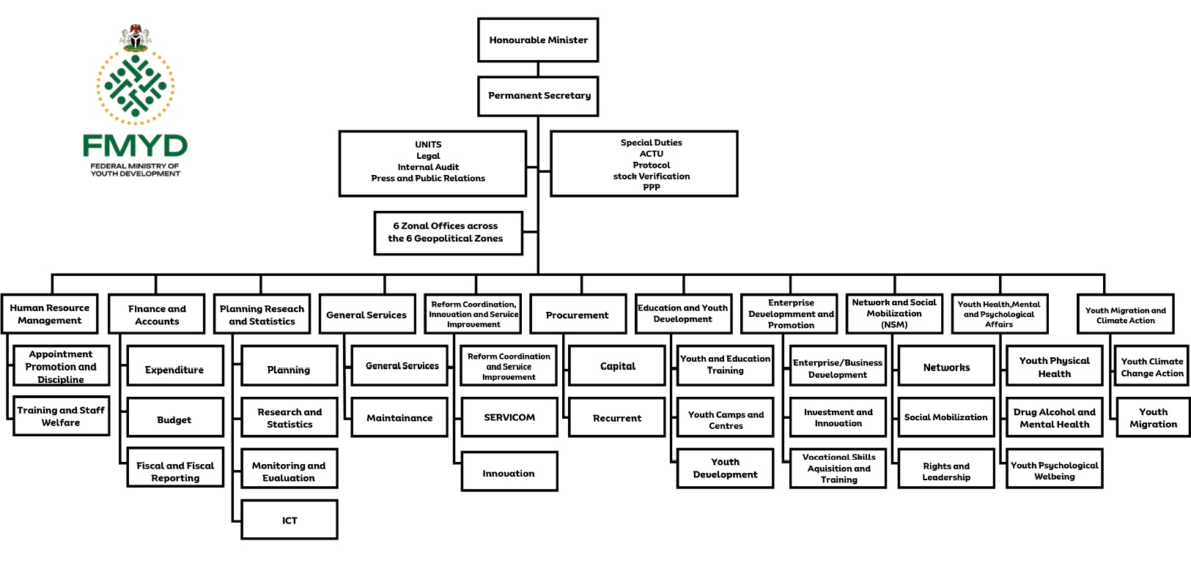
ORGANOGRAM

Slide 7
AVAILABLE POLICIES AND PLANS
Policy-aligned articulation of the Federal Ministry of Youth Development’s Ministerial Flagship Programmes, framed as strategic interventions to drive youth empowerment, protection, and national development:
The Youth Data Protection Awareness and Training Programme (YD-PAT) is designed to equip young Nigerians with critical knowledge and skills in data privacy, cybersecurity, and responsible digital engagement.
Nigerian Youth Academy (NiYA): The Nigerian Youth Academy (NiYA) serves as a national capacity-building platform aimed at equipping youth with 21st-century skills, leadership competencies, and entrepreneurial capabilities.
YouthCred Programme: The YouthCred Programme is a financial inclusion initiative that seeks to bridge the gap between young people and access to credit facilities. Recognizing that many youth lack collateral or credit history, the programme will deploy innovative credit-scoring mechanisms based on alternative data.
Comprenuer Support Scheme: The Comprenuer Support Scheme (Creative + Entrepreneur) is tailored to support youth in the creative and cultural industries, including music, film, fashion, digital content creation, and arts.

Slide 8
AVAILABLE POLICIES AND PLANS CON’T
Yo! Health Programme: The Yo! Health Initiative Programme focuses on improving the physical, mental, and social well-being of Nigerian youth. It addresses critical issues such as substance abuse, mental health awareness, sexual and reproductive health, and access to youth-friendly health services.
Circular Economy Initiative: The Circular Economy Initiative promotes sustainable development by engaging youth in waste-to-wealth opportunities, recycling, green entrepreneurship, and environmental stewardship.
Professionalization of Youth Work: The Professionalization of Youth Work programme seeks to institutionalize youth development practice as a recognized profession in Nigeria. It will establish standardized training curricula, certification systems, and accreditation frameworks for youth workers. .
Nigerian Youth Help Desk: The Nigerian Youth Help Desk is a responsive support system designed to address complaints, inquiries, and challenges faced by young people, including issues such as unemployment, exploitation, and police harassment.
Investonaire Academy: The Investonaire Academy is a financial literacy and investment education programme aimed at building a generation of financially savvy Nigerian youth.

Slide 9
AVAILABLE POLICIES AND PLANS CON’T
Nigeria Youth Investment Fund (NYIF): The Nigeria Youth Investment Fund (NYIF) is a flagship financing mechanism designed to provide accessible funding to youth-led enterprises and initiatives. NYIF will offer grants, loans, and equity financing to support start-ups and existing businesses across various sectors.
CONCLUSION
Collectively, these flagship programmes represent a comprehensive and integrated policy framework aimed at empowering Nigerian youth through skills development, financial inclusion, health, innovation, and institutional support. By addressing both opportunities and challenges—such as unemployment, digital vulnerability, and social exclusion—the Ministry is positioning youth as central drivers of national transformation and sustainable development

Slide 10
EXECUTIVE SUMMARY
Nigeria’s economic future is inextricably linked to its youth population. The 2025 National Progress Report indicates a year of significant structural advancement in the youth entrepreneurship ecosystem, marked by a shift from foundational skill-building to the professionalization of support systems and the creation of sustainable financing mechanisms. While substantial gains were made in digital literacy, mentorship, and infrastructure (e.g., the Nigeria Youth Academy, PPP-driven hubs), the primary bottleneck remains capital mobilization. The 2026 mandate focuses on operationalizing new financial instruments (Youth Bank, YouthCred) to convert trained talent into viable, scalable businesses.

Slide 11
CONCEPTUAL & THEORETICAL PERSPECTIVE
Moving from “lack of jobs” to a full Entrepreneurial Ecosystem Model
Requires 4 types of capital:
Human Capital (Skills)
Financial Capital (Loans/Grants)
Social Capital (Mentorship & Networks)
Institutional Capital (Policy & Regulation)
Key Theories Applied:
Human Capital Theory → Nigeria Youth Academy & Digital Training
Institutional Theory → Youth Bank Bill & Certification
Resilience Theory → Yo! Health & Peace-building initiatives

Slide 12
HISTORICAL TRENDS & EVOLUTION
FROM | TO
Job-seeking & Vocational Training | Enterprise Creation
Ad-hoc Grants & Handouts | Sustainable Finance (Youth Bank, NYIF, YouthCred)
Government-Led Programs | Public-Private Partnership (PPP) Models
Training without Capital | Focus on Enterprise Conversion
Sit Dolor Amet
2025 Report Insight: Training alone is not enough — Capital is the missing link

Slide 13
STRATEGIC FRAMEWORKS MULTI-LAYERED APPROACH
Financing Framework
Youth Bank (Institutional capital)
NYIF (Scale-up capital)
YouthCred (Grassroots micro-loans)
2. Human Capital Framework
NIYA → Investonaire Academy → Mentorship & Apprenticeship
3. Infrastructure Framework
PPP-driven self-sustaining Youth Economic Hubs
4. Regulatory Framework
Standardized Youth Practitioner Certification
NYSC Entrepreneurship Modernization
Sit Dolor Amet

Slide 14
KEY STAKEHOLDERS & ACTORS
Government: FMYD (Lead), NYSC, CLTC, National Assembly, other Federal MDAs, and State Ministries.
Private Sector: Investors, PPP partners, Tech companies (Cybersecurity, Cloud)
Development Partners: 28 strategic collaborations
Beneficiaries:
61,000+ digitally trained youth
286,000 in mentorship programs
64,745 active NIYA learners
Civil Society: Corpreneur Scheme & Help Desk
Sit Dolor Amet

Slide 15
2025 PERFORMANCE EVALUATION
Key Indicators
INDICATOR | PERFORMANCE | STATUS
Financing Architecture | Youth Bank Bill 95% done, YouthCred launched | Structural progress but liquidity gap
Digital Human Capital | Youth Bank Bill 95% done, YouthCred launched | Exceeds targets
Mentorship & Training | 61,000+ trained, 64,745 NIYA learners | Strong reach
Infrastructure & PPP | 286,000 mentored, 43 initiatives | High success
Enterprise Conversion | 4 centers rehabilitated, ₦105m returns | Critical weakness
Green Economy | Modest (not quantified) | Emerging success
INDICATOR | PERFORMANCE | STATUS
Financing Architecture | Youth Bank Bill 95% done, YouthCred Launched | Structural Proogress but liquidity gap
Digital Human Capital | 61,000+ trained ,64,745 NiYA Leaners | Exceeds targets
Mentorship & Training | 286,00 mentored, 43 initiatives | Strong reach
Infrastructure & PPP | 4 centres rehabilitated, ₦105m returns | High Success
Enterprise Conversion | Modest (Not Quantified) | Critical Weakness
Green Economy | 14 programs, 3 new climate businesses | Emerging success
Sit Dolor Amet

Slide 16
COMPARATIVE ANALYSIS
Rwanda: Digital human capital & ICT leapfrogging (NIYA & YDPAT)
Botswana: Structured financing + mentorship (Youth Bank mirrors CEDA)
Brazil: Private-sector-driven training & infrastructure (PPP similar to SENAI/SENAC)
Nigeria’s Unique Advantage: Massive youth population & Integration of entrepreneurship into mandatory NYSC
Sit Dolor Amet

Slide 17
OPPORTUNITIES
Opportunities in 2026
Demographic Dividend: Huge pipeline of digitally skilled & mentored youth
Green Economy: Scalable potential in renewable energy, waste management & climate-smart agriculture
Data Economy: High demand in cybersecurity, data governance & digital services
Public Sector Innovation: Corpreneur scheme for government-led startups
Sit Dolor Amet

Slide 18
POLICY RECOMMENDATIONS (PRIORITY AREAS)
Capital Activation – Fast-track Youth Bank & NYIF recapitalization (Highest Priority)
Scale YouthCred nationwide and remove KYC barriers for youth
One-Stop-Shop digital platform for business registration & compliance
Tax incentives for private companies that fund or contract youth startups
Integrate Yo! Health as a requirement for accessing Youth Bank loans
Sit Dolor Amet

Slide 19
CHALLENGES
The Federal Ministry of Youth Development faces a mix of structural, financial, and socio-economic challenges. These are not just theoretical; they show up daily in implementation gaps, youth dissatisfaction, and limited policy impact. They are as follows:
Inadequate and Unpredictable Funding: Budget allocations are often insufficient relative to the scale of Nigeria’s youth population. Even when funds are approved, delayed releases and poor cash flow make sustained programming difficult;
Data Systems and Planning Gaps: A major issue is the absence of a reliable, up-to-date youth database. Without credible data: Targeting beneficiaries becomes guesswork Monitoring and evaluation are weak Policy decisions are less evidence-based;
Policy Implementation Deficit: Nigeria is not short of youth policies but implementation is inconsistent due to: Poor inter-agency coordination Lack of continuity when leadership changes Weak accountability mechanisms;
High Youth Unemployment and Underemployment: The Ministry is under pressure to address unemployment, yet: Job creation is largely outside its direct control Skills programs often don’t align with market needs Private sector engagement is still limited;

Slide 20
CHALLENGES CON’T
Limited Institutional Capacity gaps include: Shortage of skilled technical staff Limited use of digital tools for service delivery;
Fragmentation Across MDAs: Youth-related interventions are spread across multiple Ministries, Departments, and Agencies (MDAs), leading to: Duplication of efforts Resource wastage Confusion among beneficiaries;
Policy Implementation Deficit: Nigeria is not short of youth policies but implementation is inconsistent due to: Poor inter-agency coordination Lack of continuity when leadership changes Weak accountability mechanisms;
Security Challenges: In several states, insecurity affects Programme rollout, Youth participation and Monitoring activities;
Trust Deficit Among Youth: Many young people are skeptical of government programmes due to Past failures, lack of transparency, and perceived exclusion. This leads to low participation or disengagement;
Digital Divide: While digital solutions are being introduced, Many youths lack access to the internet or devices. Rural areas are underserved Digital literacy gaps persist;

Slide 21
CHALLENGES CON’T
Monitoring, Evaluation, and Impact Measurement Issues: Weak tracking of outcomes Focus on outputs (number trained) instead of impact (jobs created) Limited feedback loops for improvement;
Police Harassment and Youth Protection Concerns: A persistent challenge is the issue of harassment, profiling, and occasional abuse of young people by security agencies, particularly the Nigeria Police Force. This has: Eroded trust between youth and government institutions discouraged youth participation in formal economic activities Fuelled social tension and grievances However, this is being actively addressed through institutional responses such as the recently established Help Youth Desk within the Ministry, which aims to: Receive and document complaints provide a reporting and redress mechanism Serve as a bridge between youth and security agencies Promote accountability and protection of youth rights

Slide 22
CONCLUSION
2025 successfully built the scaffolding (skills, mentorship, infrastructure)
The missing piece is capital to drive enterprise conversion
2026 Mandate: Convert structural gains into sustainable, scalable youth businesses
Youth entrepreneurship is the engine for Nigeria’s economic diversification and long-term national development
“From Readiness to Reality – Capitalize the Demographic Dividend”
Sit Dolor Amet

Slide 23
Q/A
Thank You
Questions and Discussion
Sit Dolor Amet

